Slide 1
RUSTikales Rust for beginners
©Philippe Felix Haupt 2023-2024

Slide 2
Plan for today
©Philippe Felix Haupt 2023-2024

Slide 3
Plan for today
Recap
©Philippe Felix Haupt 2023-2024

Slide 4
Plan for today
Recap
Option and Result
©Philippe Felix Haupt 2023-2024

Slide 5
Recap
©Philippe Felix Haupt 2023-2024

Slide 6
Recap
Ownership
Borrowing
Borrow Checker
©Philippe Felix Haupt 2023-2024

Slide 7
Recap
Ownership
Borrowing
Borrow Checker
Enums
Pattern Matching
©Philippe Felix Haupt 2023-2024

Slide 8
Recap
Ownership
Borrowing
Borrow Checker
Enums
Pattern Matching
Generic Types
Allow us to generalize our code by writing data structures that work on any type
Declared by writing:
struct StructName<T, …> {}
enum EnumName<T, …> {}
fn functionName<T, …> {}
impl<T,...> for Struct/Enum<T, …> {}
The data structures are then used by providing a type for each Generic
StructName<i32>
EnumName<i32, bool>
©Philippe Felix Haupt 2023-2024

Slide 9
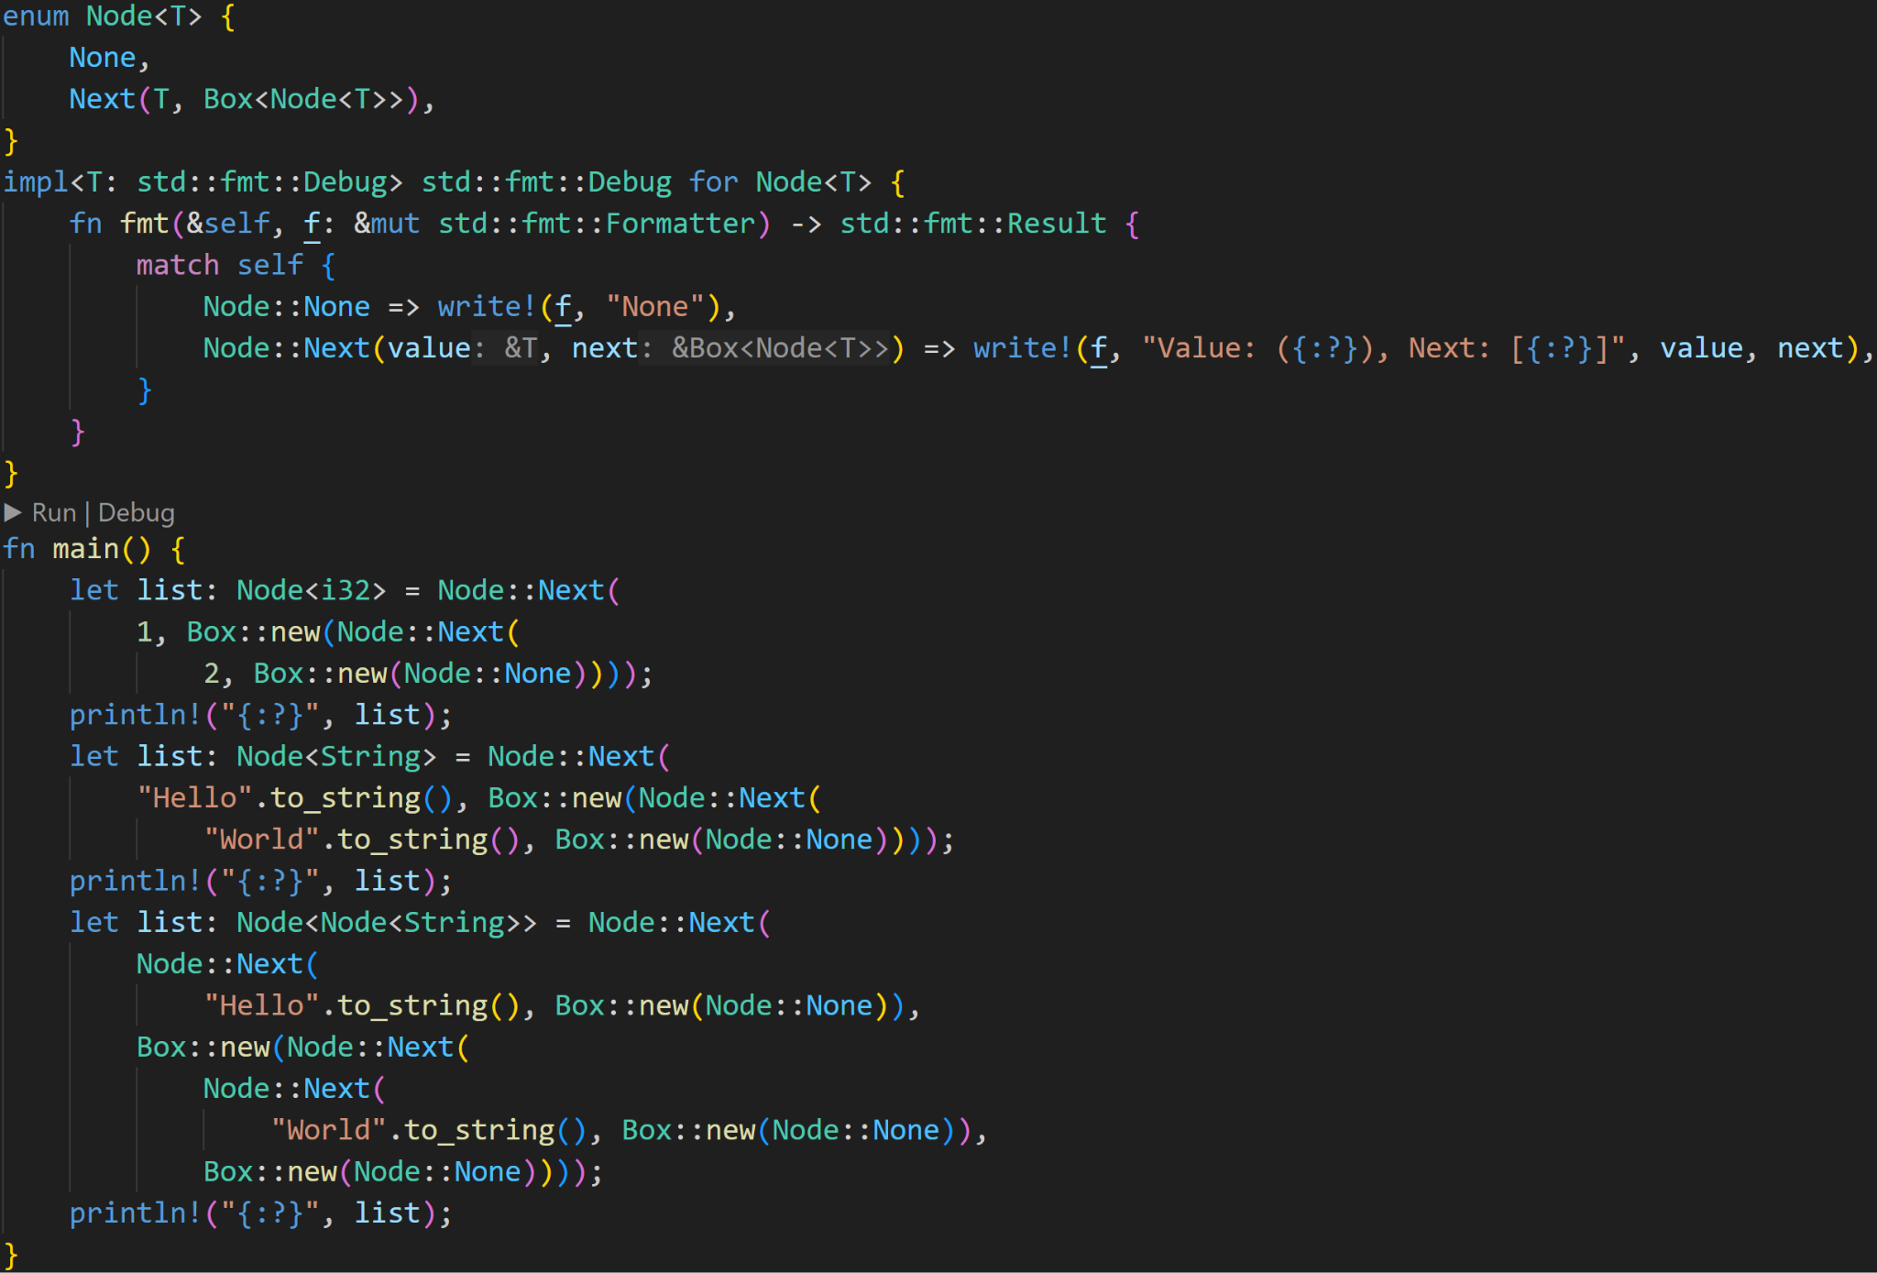
©Philippe Felix Haupt 2023-2024

Slide 10
Generic Enum with one Generic Type T
©Philippe Felix Haupt 2023-2024

Slide 11
Concrete Types for T
©Philippe Felix Haupt 2023-2024

Slide 12
Node<String> itself is also a Type, so we can also put it in here
©Philippe Felix Haupt 2023-2024

Slide 13
We can also impl generic data structures
©Philippe Felix Haupt 2023-2024

Slide 14
Trait Boundary:
Instead of being able to create any Nodes we want, the encapsulated type must implement the Debug-trait
©Philippe Felix Haupt 2023-2024

Slide 15
All print-statements call this Debug-impl
©Philippe Felix Haupt 2023-2024

Slide 16
<T>::Debug called here
This list also calls to i32::Debug
This list also calls to String::Debug
This list also calls to Node::Debug :^)
©Philippe Felix Haupt 2023-2024

Slide 17
©Philippe Felix Haupt 2023-2024

Slide 18
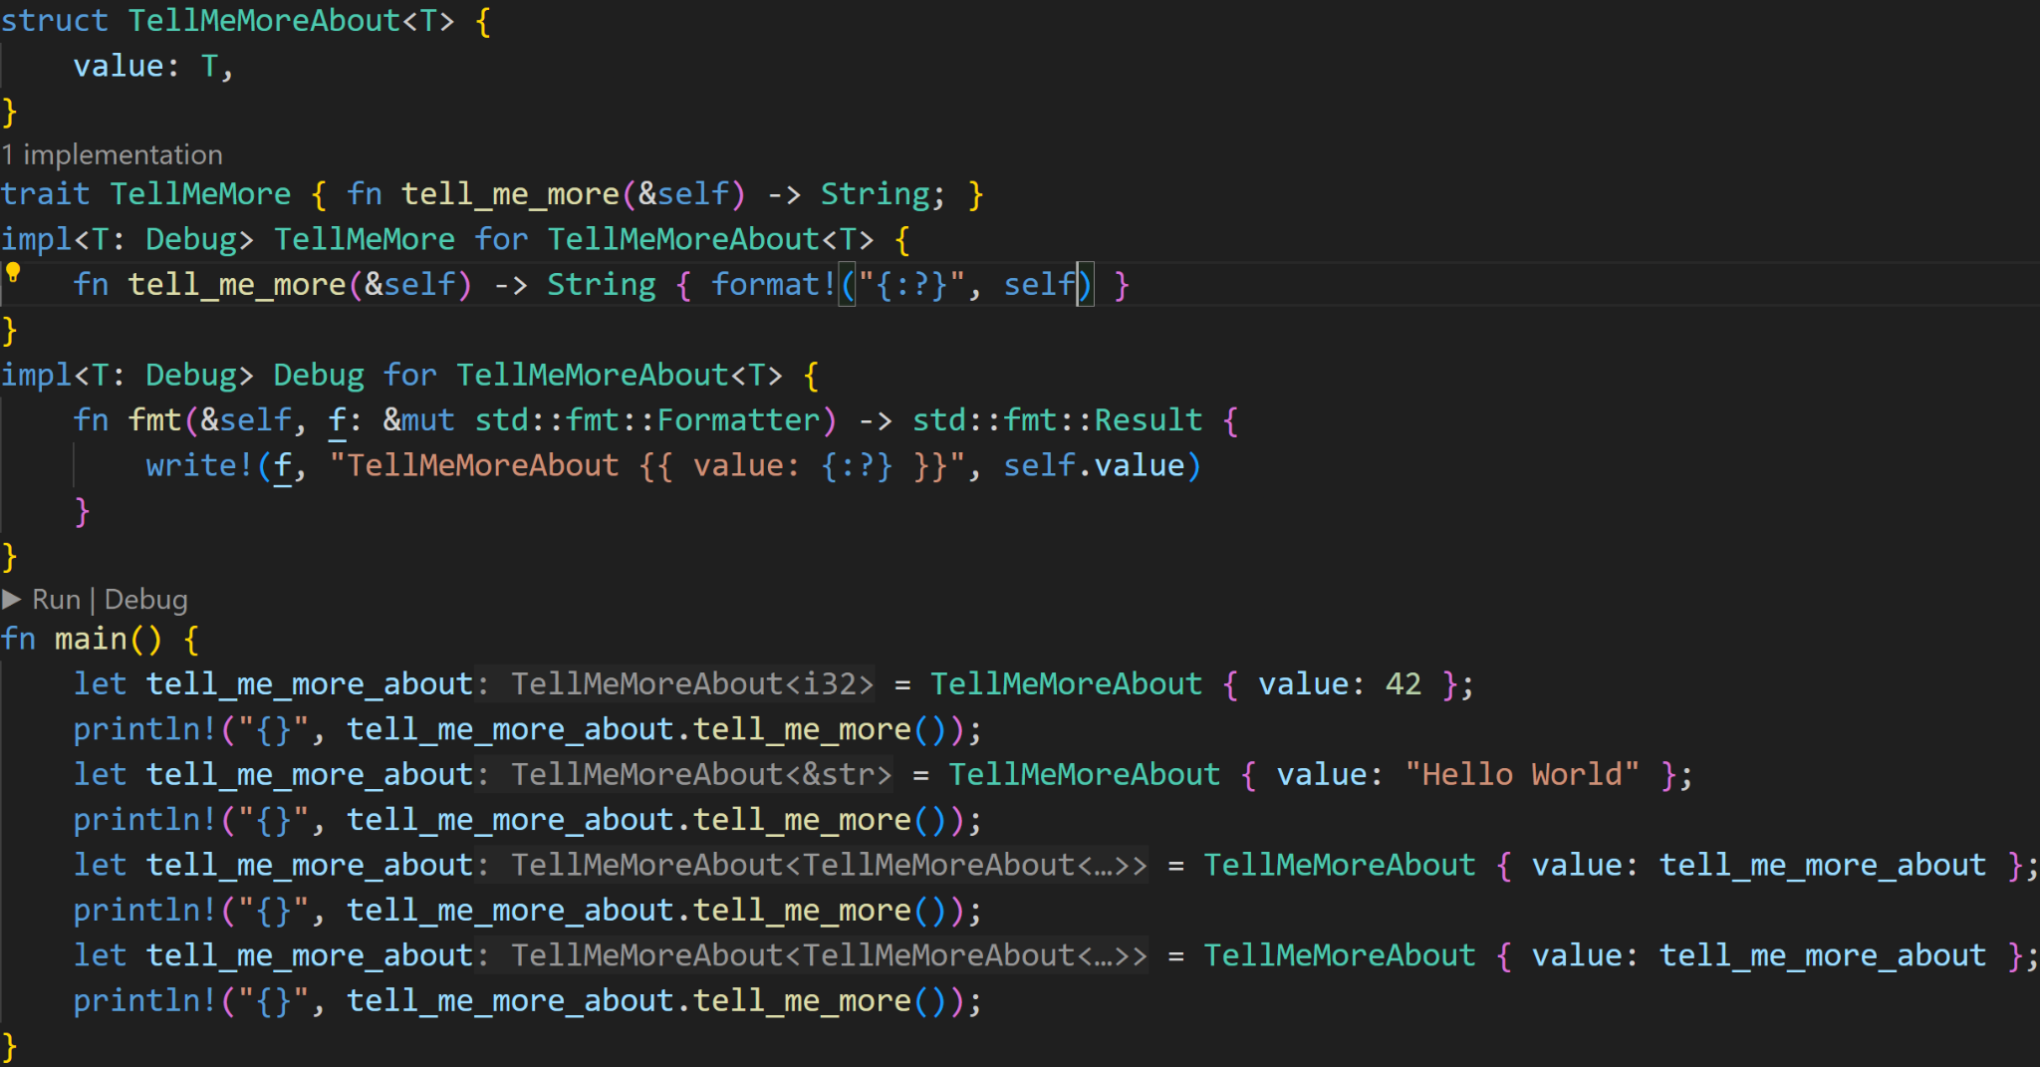
©Philippe Felix Haupt 2023-2024

Slide 19
Generic Struct with one Generic Type T
©Philippe Felix Haupt 2023-2024

Slide 20
impl as we’d usually do
©Philippe Felix Haupt 2023-2024

Slide 21
Debug format placeholder, so we need a Trait Boundary for T
©Philippe Felix Haupt 2023-2024

Slide 22
Create instances by providing a concrete type, Rust is smart enough to infer the type (here: 42 is i32)
©Philippe Felix Haupt 2023-2024

Slide 23
Are these the same type?
1/3
©Philippe Felix Haupt 2023-2024

Slide 24
Are these the same type?
1/3
top type: TellMeMoreAbout<TellMeMoreAbout<&str>>
bottom type: TellMeMoreAbout<TellMeMoreAbout<TellMeMoreAbout<&str>>> :^)
©Philippe Felix Haupt 2023-2024

Slide 25
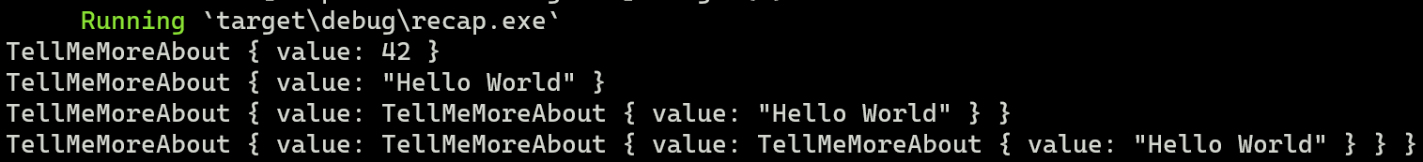
©Philippe Felix Haupt 2023-2024

Slide 26
Option and Result
With Generic Types introduced, we now know everything we need to start working on cool projects
©Philippe Felix Haupt 2023-2024

Slide 27
Option and Result
With Generic Types introduced, we now know everything we need to start working on cool projects
We can use structs
We can use enums
We can control the flow using if, for, match
We can use functions
We can use Generics
We are masters of the Ownership and Borrow Checking concepts
©Philippe Felix Haupt 2023-2024

Slide 28
Option and Result
With Generic Types introduced, we now know everything we need to start working on cool projects
Today is about two Utility and Quality of Life features which are used everywhere:
Option<T>
Result<T, E>
©Philippe Felix Haupt 2023-2024

Slide 29
Option and Result
With Generic Types introduced, we now know everything we need to start working on cool projects
Today is about two Utility and Quality of Life features which are used everywhere:
Option<T>
Result<T, E>
Additionally, we’ll also delve into what’s possible with Rust, slowly entering the domain of advanced features
©Philippe Felix Haupt 2023-2024

Slide 30
Option and Result
With Generic Types introduced, we now know everything we need to start working on cool projects
Today is about two Utility and Quality of Life features which are used everywhere:
Option<T>
Result<T, E>
Additionally, we’ll also delve into what’s possible with Rust, slowly entering the domain of advanced features
Because we’re technically not introducing anything new today, there won’t be exercises for this week and at the end of the session
Options and Results are used so often, you’ll understand them very soon ^^
©Philippe Felix Haupt 2023-2024

Slide 31
Option and Result
The plan for today:
Create a console application that takes some arguments in the CLI, and does stuff with it
©Philippe Felix Haupt 2023-2024

Slide 32
Option and Result
The plan for today:
Create a console application that takes some arguments in the CLI, and does stuff with it
It needs to handle the arguments, and call various functions based on them
©Philippe Felix Haupt 2023-2024

Slide 33
Option and Result
The plan for today:
Create a console application that takes some arguments in the CLI, and does stuff with it
It needs to handle the arguments, and call various functions based on them
It needs to handle the absence of arguments
©Philippe Felix Haupt 2023-2024

Slide 34
Option and Result
The plan for today:
Create a console application that takes some arguments in the CLI, and does stuff with it
It needs to handle the arguments, and call various functions based on them
It needs to handle the absence of arguments
It needs to handle unknown arguments
©Philippe Felix Haupt 2023-2024

Slide 35
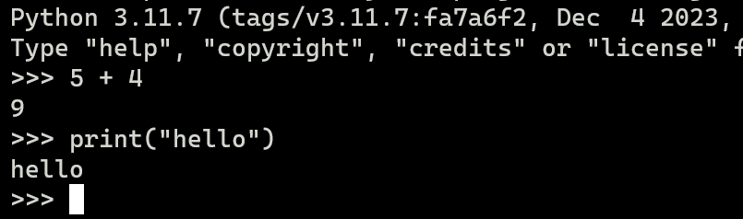
Option and Result
The plan for today:
Create a console application that takes some arguments in the CLI, and does stuff with it
It needs to handle the arguments, and call various functions based on them
It needs to handle the absence of arguments
It needs to handle unknown arguments
The application will be interactive, so we’re implementing a REPL:
The user can enter lines, which are the input of our program:
©Philippe Felix Haupt 2023-2024

Slide 36
Option and Result
Let’s start with the hardest part: Getting input from the console
Once we have the input, doing stuff with it is just a simple thing of calling functions
©Philippe Felix Haupt 2023-2024

Slide 37
Option and Result
Let’s start with the hardest part: Getting input from the console
Once we have the input, doing stuff with it is just a simple thing of calling functions
This is already where it gets interesting:
Getting input from the console may fail for various reasons
Rust has UTF-8 strings, what if you input invalid UTF-8?
What if the console closes before Rust reads it successfully?
etcetc
©Philippe Felix Haupt 2023-2024

Slide 38
Option and Result
Let’s start with the hardest part: Getting input from the console
Once we have the input, doing stuff with it is just a simple thing of calling functions
This is already where it gets interesting:
Getting input from the console may fail for various reasons
Rust has UTF-8 strings, what if you input invalid UTF-8?
What if the console closes before Rust reads it successfully?
etcetc
Exactly for that reason, the function that gets the input does not return a String, it returns a Result
©Philippe Felix Haupt 2023-2024

Slide 39
Option and Result
Result<T, E> is the way of handling errors in Rust
©Philippe Felix Haupt 2023-2024

Slide 40
Option and Result
Result<T, E> is the way of handling errors in Rust
Rust does not have exceptions, so you won’t find try-catch anywhere
Instead, functions that are error-prone (so, functions that can fail) return Results
©Philippe Felix Haupt 2023-2024

Slide 41
Option and Result
Result<T, E> is the way of handling errors in Rust
Rust does not have exceptions, so you won’t find try-catch anywhere
Instead, functions that are error-prone (so, functions that can fail) return Results
It’s then up to the caller of the function to handle the error:
Should we continue?
Should we panic?
Maybe we’ll just propagate the error up the call chain
©Philippe Felix Haupt 2023-2024

Slide 42
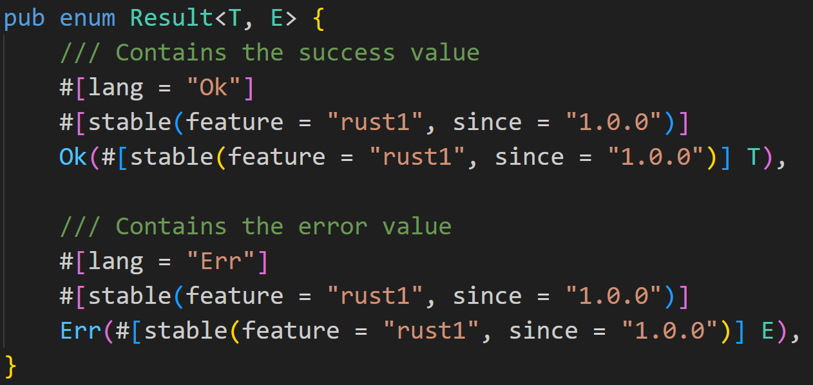
Option and Result
Result<T, E> is an Enum Type, defined as follows:
©Philippe Felix Haupt 2023-2024

Slide 43
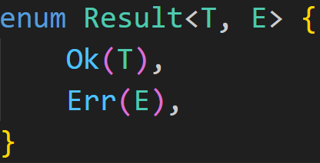
Option and Result
Result<T, E> is an Enum Type, less noisy defined as follows:
©Philippe Felix Haupt 2023-2024

Slide 44
Option and Result
Result<T, E> is an Enum Type, less noisy defined as follows:
We create and return this Variant when everything is fine
We create and return this Variant when an error happened
©Philippe Felix Haupt 2023-2024

Slide 45
Option and Result
Result<T, E> is an Enum Type, less noisy defined as follows:
Both types are generic, so we can create whatever Results we want:
Result<i32, String>
Result<bool, CustomStruct>
Result<(), usize>
©Philippe Felix Haupt 2023-2024

Slide 46
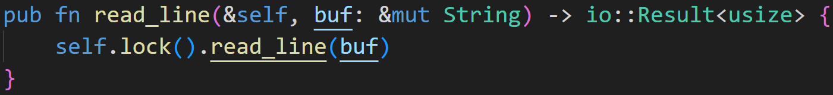
Option and Result
In the case of reading input from the console, the function is defined as follows:
©Philippe Felix Haupt 2023-2024

Slide 47
Option and Result
In the case of reading input from the console, the function is defined as follows:
io::Result is NOT the normal Result :^) See how it only specifies one generic type?
©Philippe Felix Haupt 2023-2024

Slide 48
Option and Result
In the case of reading input from the console, the function is defined as follows:
io::Result is NOT the normal Result :^) See how it only specifies one generic type?
io::Result is defined as:
©Philippe Felix Haupt 2023-2024

Slide 49
Option and Result
In the case of reading input from the console, the function is defined as follows:
io::Result is NOT the normal Result :^) See how it only specifies one generic type?
io::Result is defined as:
This is the normal Result, we got two generic types now :)
©Philippe Felix Haupt 2023-2024

Slide 50
Option and Result
In the case of reading input from the console, the function is defined as follows:
io::Result is NOT the normal Result :^) See how it only specifies one generic type?
io::Result is defined as:
Layers and layers of abstraction, this is a custom struct defined in std::io, we can ignore it, it implements everything we need (Display and Debug) :^)
©Philippe Felix Haupt 2023-2024

Slide 51
Option and Result
Okay, we can now use that function, and see how it goes:
©Philippe Felix Haupt 2023-2024

Slide 52
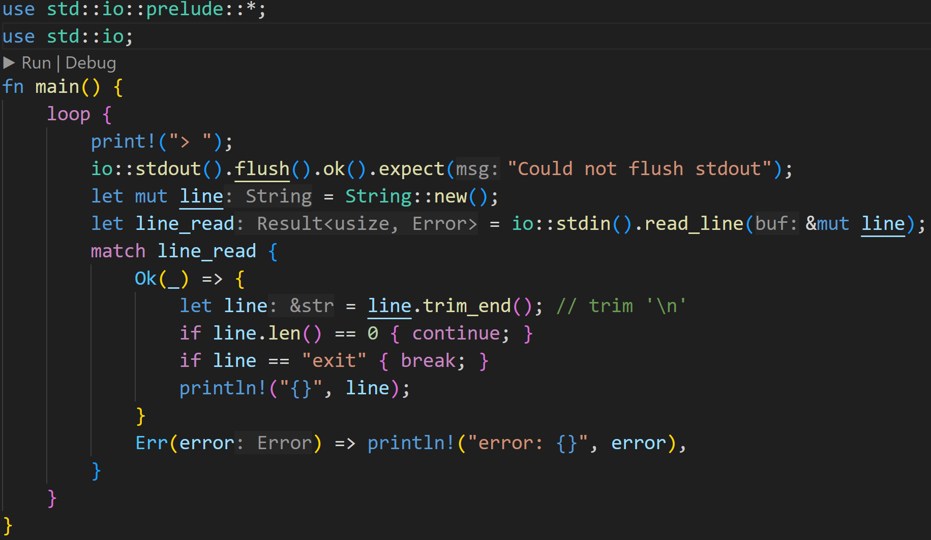
Option and Result
©Philippe Felix Haupt 2023-2024

Slide 53
Option and Result
This is the important line
©Philippe Felix Haupt 2023-2024

Slide 54
Option and Result
as we’ve discussed, reading the current line from stdin may fail, so the function returns a Result
©Philippe Felix Haupt 2023-2024

Slide 55
Option and Result
Result being an Enum means we can Pattern Match all cases, and handle them separately
©Philippe Felix Haupt 2023-2024

Slide 56
Option and Result
We just print it and continue as normal
The case of “Something went wrong!” - an error happened
©Philippe Felix Haupt 2023-2024

Slide 57
Option and Result
The case of “Everything is okay!” - We successfully read a line and stored the result in line
©Philippe Felix Haupt 2023-2024

Slide 58
Option and Result
read_line() returns how many bytes were read, but we don’t care about that, so we match with the wildcard
©Philippe Felix Haupt 2023-2024

Slide 59
Option and Result
If we enter ‘exit’, we exit the loop
For now, we’re just printing it back to the console
©Philippe Felix Haupt 2023-2024

Slide 60
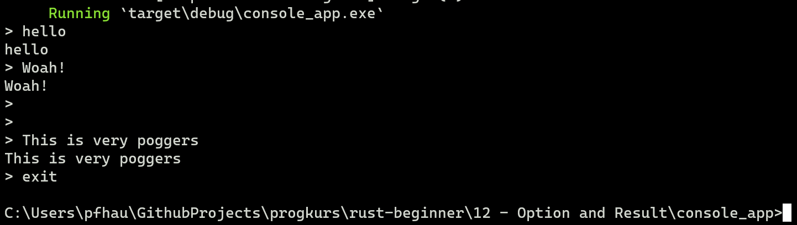
Option and Result
Running this code, we get the following:
©Philippe Felix Haupt 2023-2024

Slide 61
Option and Result
Running this code, we get the following:
I entered ‘hello’
©Philippe Felix Haupt 2023-2024

Slide 62
Option and Result
Running this code, we get the following:
I entered ‘hello’
line contains ‘hello\n’ line_read is Ok()
©Philippe Felix Haupt 2023-2024

Slide 63
Option and Result
Running this code, we get the following:
I entered ‘hello’
line contains ‘hello\n’ line_read is Ok()
‘hello’ is not empty
©Philippe Felix Haupt 2023-2024

Slide 64
Option and Result
Running this code, we get the following:
I entered ‘hello’
line contains ‘hello\n’ line_read is Ok()
‘hello’ != ‘exit’
©Philippe Felix Haupt 2023-2024

Slide 65
Option and Result
Running this code, we get the following:
I entered ‘hello’
line contains ‘hello\n’ line_read is Ok()
We print ‘hello’
©Philippe Felix Haupt 2023-2024

Slide 66
Option and Result
Running this code, we get the following:
We’re in a loop, we jump back up here and continue reading input
©Philippe Felix Haupt 2023-2024

Slide 67
Option and Result
Running this code, we get the following:
Line is empty, we continue and don’t print anything
©Philippe Felix Haupt 2023-2024

Slide 68
Option and Result
Running this code, we get the following:
‘exit’ breaks the loop, we exit the program
©Philippe Felix Haupt 2023-2024

Slide 69
Option and Result
Instead of just printing the input, we can now define some basic commands, similar to exit
In case of an unknown command, we would like to print an error, and continue
©Philippe Felix Haupt 2023-2024

Slide 70
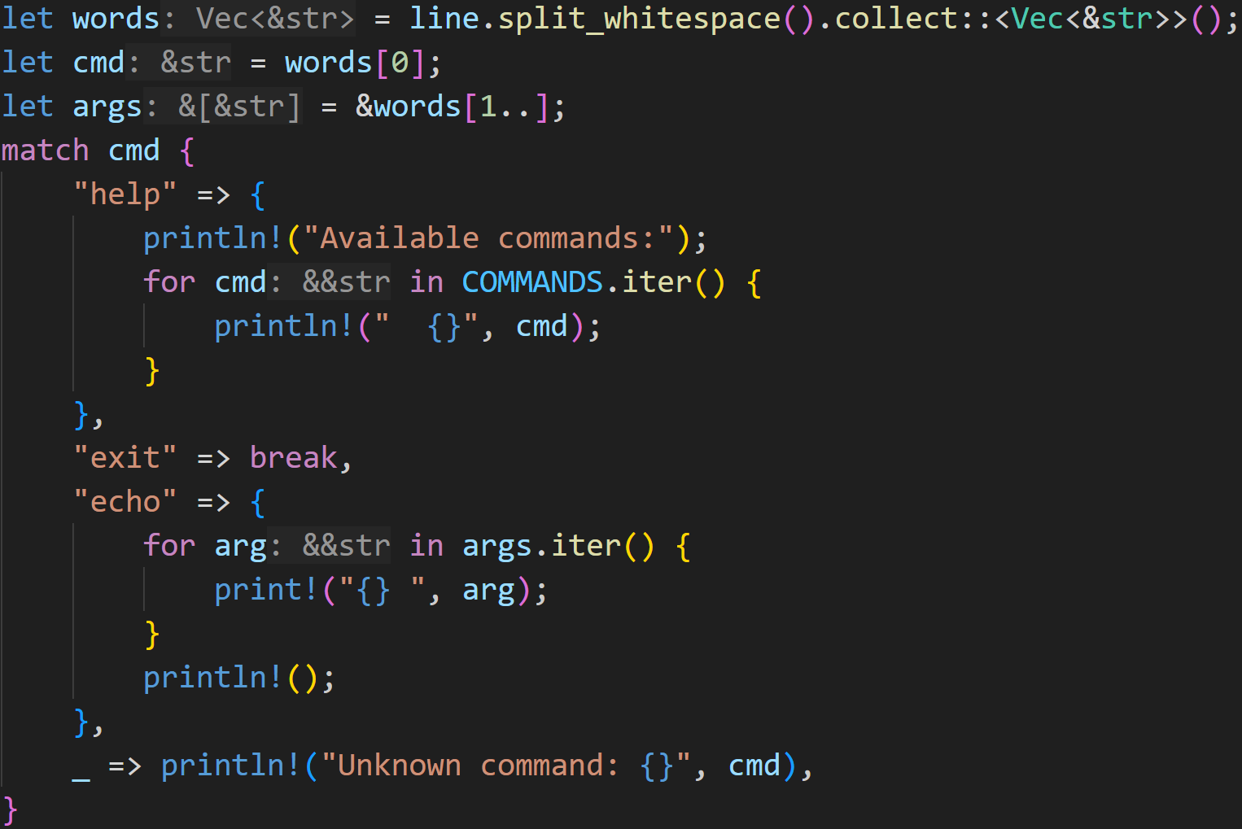
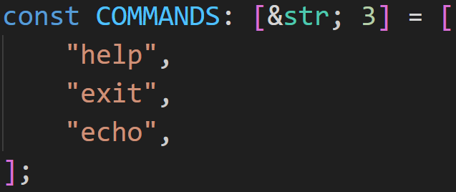
Option and Result
This code is a bit more complicated, we now have several commands we accept
Note: This is all happening in the Ok() branch
©Philippe Felix Haupt 2023-2024

Slide 71
Option and Result
The first word is always the command
Arguments come after
Note: This is all happening in the Ok() branch
©Philippe Felix Haupt 2023-2024

Slide 72
Option and Result
Note: This is all happening in the Ok() branch
Depending on the command we entered, we can now do different things
©Philippe Felix Haupt 2023-2024

Slide 73
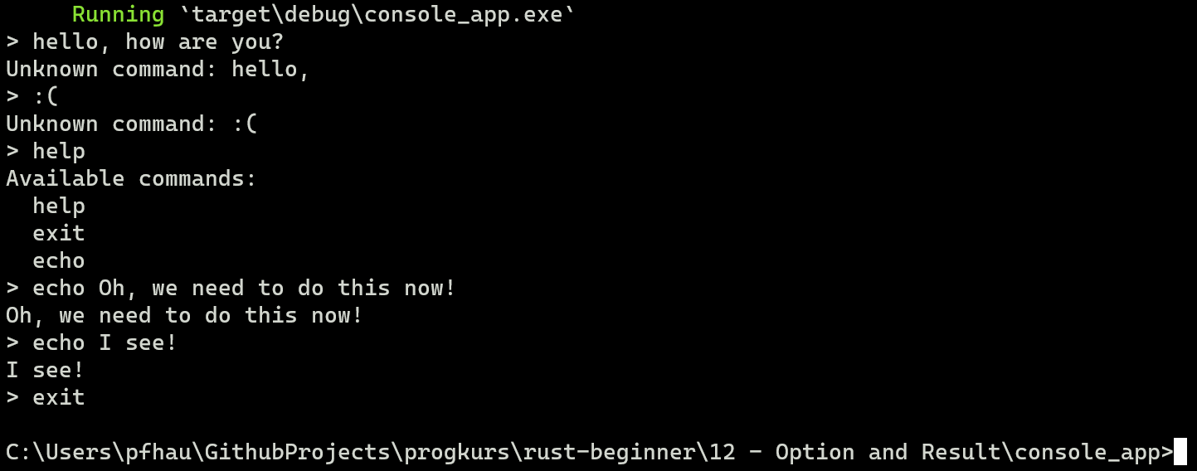
Option and Result
Running this code, we get the following:
©Philippe Felix Haupt 2023-2024

Slide 74
Option and Result
Running this code, we get the following:
Unknown commands
Handled here
©Philippe Felix Haupt 2023-2024

Slide 75
Option and Result
Running this code, we get the following:
help goes into the help branch, and lists all commands
Handled here
©Philippe Felix Haupt 2023-2024

Slide 76
Option and Result
Running this code, we get the following:
echo prints whatever we wrote, without the ‘echo’
Handled here
©Philippe Felix Haupt 2023-2024

Slide 77
Option and Result
Running this code, we get the following:
exit still exits the program
Handled here
©Philippe Felix Haupt 2023-2024

Slide 78
Option and Result
Next, it would be super cool to have a command that prints the contents of a file
Reading a file might also fail, so that also returns a Result :)
For example, the file might not exist
©Philippe Felix Haupt 2023-2024

Slide 79
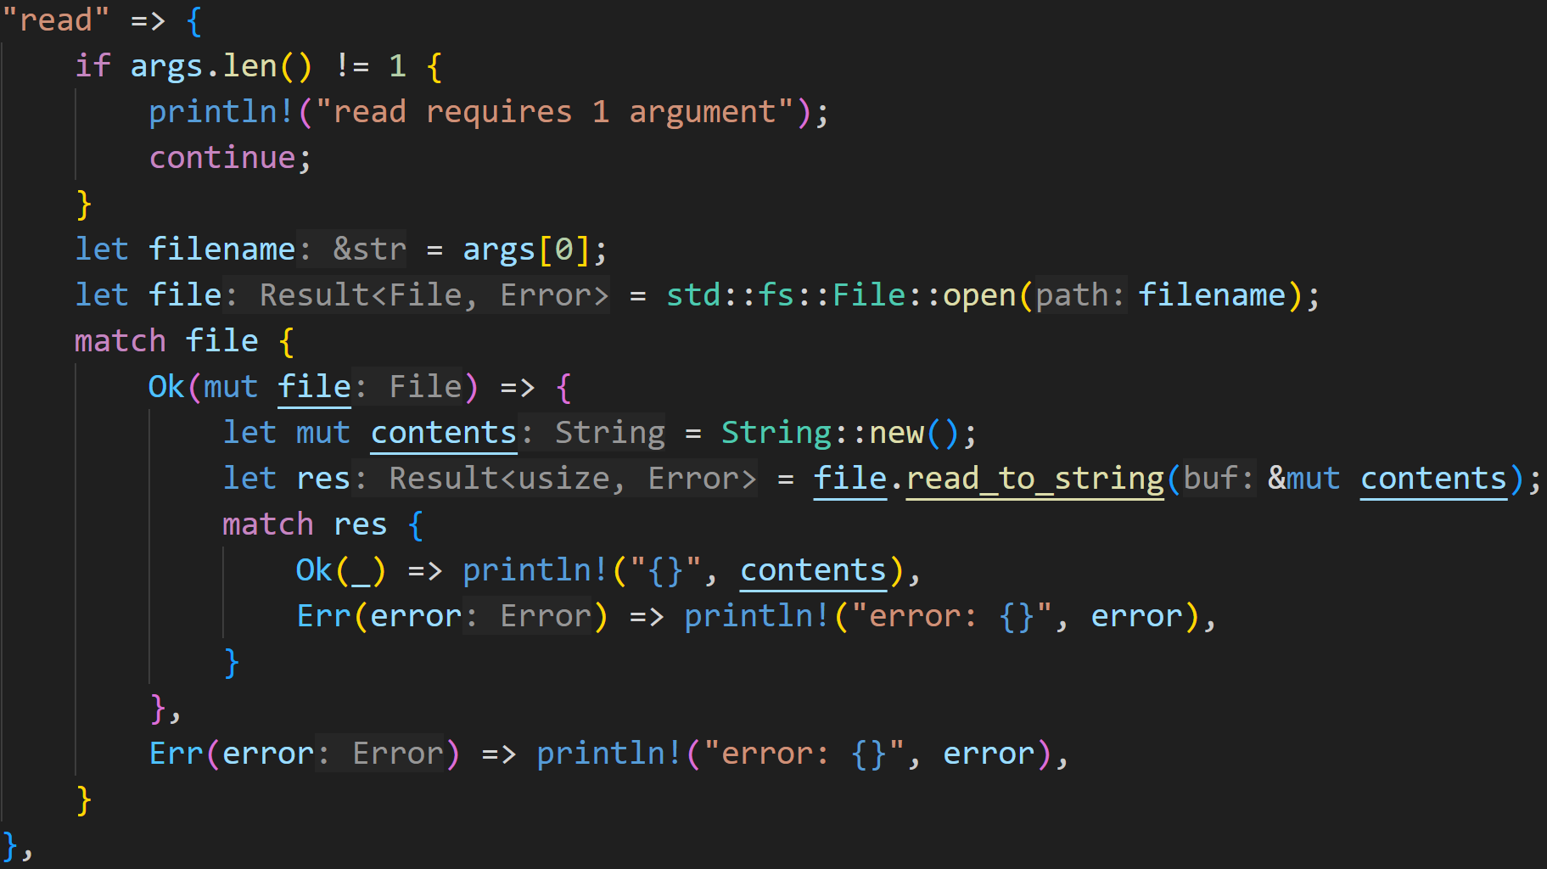
Option and Result
©Philippe Felix Haupt 2023-2024

Slide 80
Option and Result
We only want to read one file at a time
©Philippe Felix Haupt 2023-2024

Slide 81
Option and Result
File::open() may fail if the file does not exist, so it returns a Result
©Philippe Felix Haupt 2023-2024

Slide 82
Option and Result
Reading the file may also fail :^)
©Philippe Felix Haupt 2023-2024

Slide 83
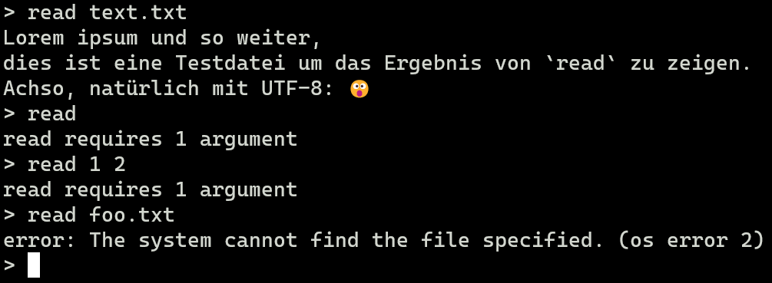
Option and Result
©Philippe Felix Haupt 2023-2024

Slide 84
Option and Result
Now, let’s dive a bit into the craziness of Rust, and improve our code:
Functions in Rust are so called first-class citizen, which means we can treat them as all other values and variables :)
©Philippe Felix Haupt 2023-2024

Slide 85

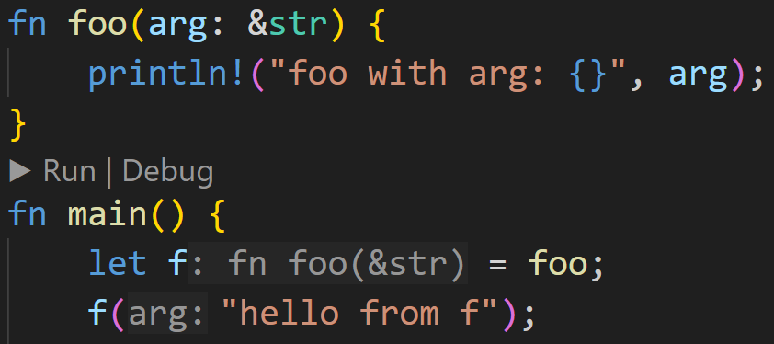
Option and Result
Now, let’s dive a bit into the craziness of Rust, and improve our code:
Functions in Rust are so called first-class citizen, which means we can treat them as all other values and variables :)
All of this will be covered in depth in the advanced course next semester, I’ll give you a crash course now:
©Philippe Felix Haupt 2023-2024

Slide 86
Option and Result
Now, let’s dive a bit into the craziness of Rust, and improve our code:
Functions in Rust are so called first-class citizen, which means we can treat them as all other values and variables :)
All of this will be covered in depth in the advanced course next semester, I’ll give you a crash course now:
We can store functions in variables, store them in structs, etc
and call them ‘by proxy’
©Philippe Felix Haupt 2023-2024

Slide 87
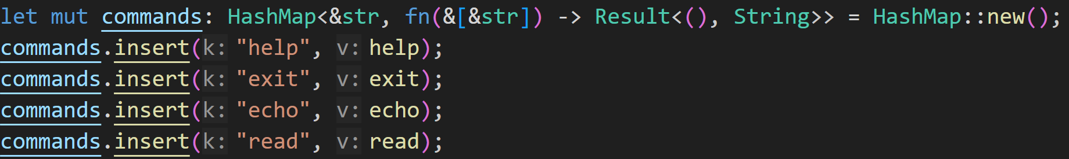
Option and Result
We can now define a hashmap of functions, for easier use later on
©Philippe Felix Haupt 2023-2024

Slide 88
Option and Result
Explicit type definition is needed here:
key type is &str
value type is fn(&[&str]) -> Result<(), String>
This means we can put all functions as values in there which:
- Take in a single parameter: A slice of string literals
- Return a Result<(), String>
©Philippe Felix Haupt 2023-2024

Slide 89
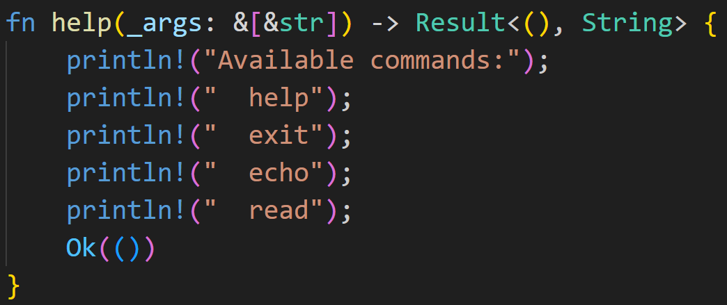
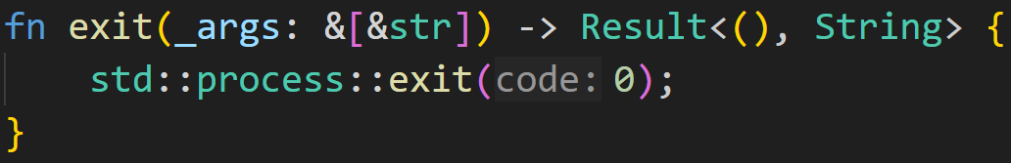
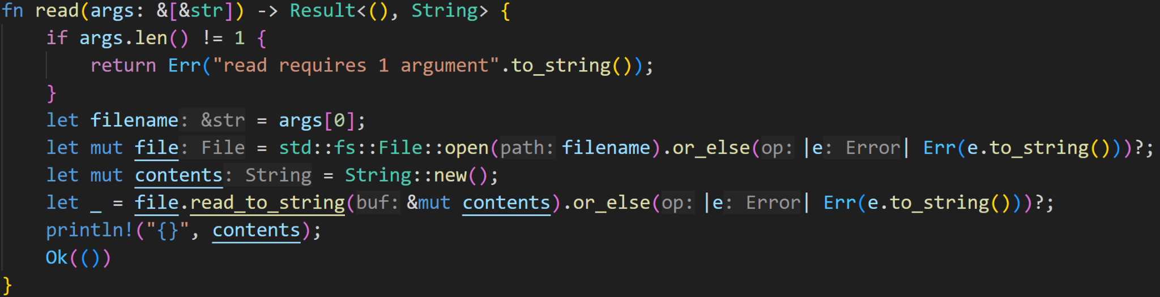
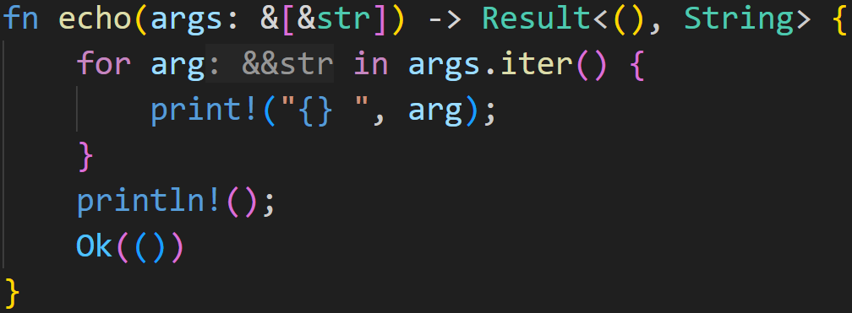
Option and Result
©Philippe Felix Haupt 2023-2024

Slide 90
Option and Result
©Philippe Felix Haupt 2023-2024

Slide 91
Option and Result
Okay, this is extremely complicated, what does it do for us?
©Philippe Felix Haupt 2023-2024

Slide 92
Option and Result
Okay, this is extremely complicated, what does it do for us?
Well, it allows us to easily look up commands by making use of HashMap::get()
©Philippe Felix Haupt 2023-2024

Slide 93
Option and Result
Okay, this is extremely complicated, what does it do for us?
Well, it allows us to easily look up commands by making use of HashMap::get()
However, this leads to the next questions:
What does get() return if the HashMap does not contain the command?
What does get() return in general?
©Philippe Felix Haupt 2023-2024

Slide 94
Option and Result
Okay, this is extremely complicated, what does it do for us?
Well, it allows us to easily look up commands by making use of HashMap::get()
However, this leads to the next questions:
What does get() return if the HashMap does not contain the command?
What does get() return in general?
As you might guess already, we also have a problem here:
If the HashMap does not contain a certain key, there is no value associated with it
get() can’t return anything!
©Philippe Felix Haupt 2023-2024

Slide 95
Option and Result
Okay, this is extremely complicated, what does it do for us?
Well, it allows us to easily look up commands by making use of HashMap::get()
However, this leads to the next questions:
What does get() return if the HashMap does not contain the command?
What does get() return in general?
As you might guess already, we also have a problem here:
If the HashMap does not contain a certain key, there is no value associated with it
get() can’t return anything!
How do we specify this in Rust?
Rust does not have null, everything has to have a value
Luckily, we can apply the same trick as we used for our List last week :)
Or rather, this is what Rust does with Option<T>
©Philippe Felix Haupt 2023-2024

Slide 96
Option and Result
Option<T> is the way of handling absent values in Rust
©Philippe Felix Haupt 2023-2024

Slide 97
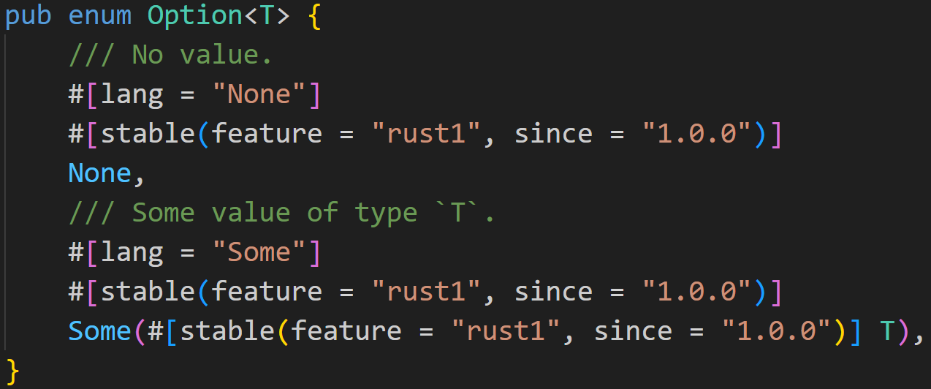
Option and Result
Option<T> is the way of handling absent values in Rust
Option<T> is defined as:
©Philippe Felix Haupt 2023-2024

Slide 98
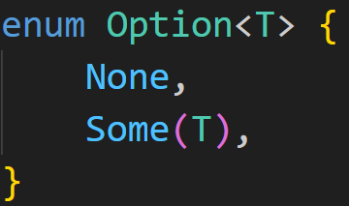
Option and Result
Option<T> is the way of handling absent values in Rust
Option<T> is less noisy defined as:
©Philippe Felix Haupt 2023-2024

Slide 99
Option and Result
Option<T> is the way of handling absent values in Rust
Option<T> is less noisy defined as:
We create and return this Variant if we have no value
We create and return this Variant if we have a value, we’re wrapping it into this Variant
©Philippe Felix Haupt 2023-2024

Slide 100
Option and Result
Option<T> is the way of handling absent values in Rust
Options are used anywhere where you can have no value, like HashMap::get()
©Philippe Felix Haupt 2023-2024

Slide 101
Option and Result
Option<T> is the way of handling absent values in Rust
Options are used anywhere where you can have no value, like HashMap::get()
What do we gain from this? What’s the advantage over having a null-Value?
2/3
©Philippe Felix Haupt 2023-2024

Slide 102
Option and Result
Option<T> is the way of handling absent values in Rust
Options are used anywhere where you can have no value, like HashMap::get()
What do we gain from this? What’s the advantage over having a null-Value?
For the Type Checker Option<T> is a different type than T, so we can’t accidentally assign it to variables of type T
Other languages do not differentiate, you can freely assign null to variables of type T
If a variable is of type T, it always has a value
You don’t need Null-Checks at runtime, it can all be statically checked at compile time
2/3
©Philippe Felix Haupt 2023-2024

Slide 103
Option and Result
Option<T> is the way of handling absent values in Rust
Options are used anywhere where you can have no value, like HashMap::get()
What do we gain from this? What’s the advantage over having a null-Value?
For the Type Checker Option<T> is a different type than T, so we can’t accidentally assign it to variables of type T
Other languages do not differentiate, you can freely assign null to variables of type T
If a variable is of type T, it always has a value
You don’t need Null-Checks at runtime, it can all be statically checked at compile time
The downside is the so called unwrap-hell in Rust, because you always have to unwrap your Option<T> or Result<T, E> to access the underlying T
Either done using Pattern Matching (syntactic noise) or done by calling .unwrap() on your Option/Result, which may panic if your Option is None or your Result is Err()
©Philippe Felix Haupt 2023-2024

Slide 104
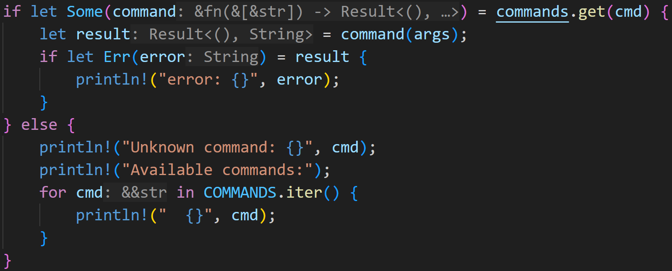
Option and Result
©Philippe Felix Haupt 2023-2024

Slide 105
Option and Result
Get the command
©Philippe Felix Haupt 2023-2024

Slide 106
Option and Result
Get the command
if the HashMap contains our key, get() returns Some(fn)
©Philippe Felix Haupt 2023-2024

Slide 107
Option and Result
Get the command
if the HashMap contains our key, get() returns Some(fn)
else we drop down here, and print the error
©Philippe Felix Haupt 2023-2024

Slide 108
Option and Result
As we’ve seen many slides ago, command is a function-by-proxy, so we can call it like a normal function
©Philippe Felix Haupt 2023-2024

Slide 109
Option and Result
The return type of the functions inside the HashMap was declared to be Result<(), String>
©Philippe Felix Haupt 2023-2024

Slide 110
Option and Result
if the subcommand failed, we print the error (for example, if read foo.txt could not find the file)
©Philippe Felix Haupt 2023-2024

Slide 111
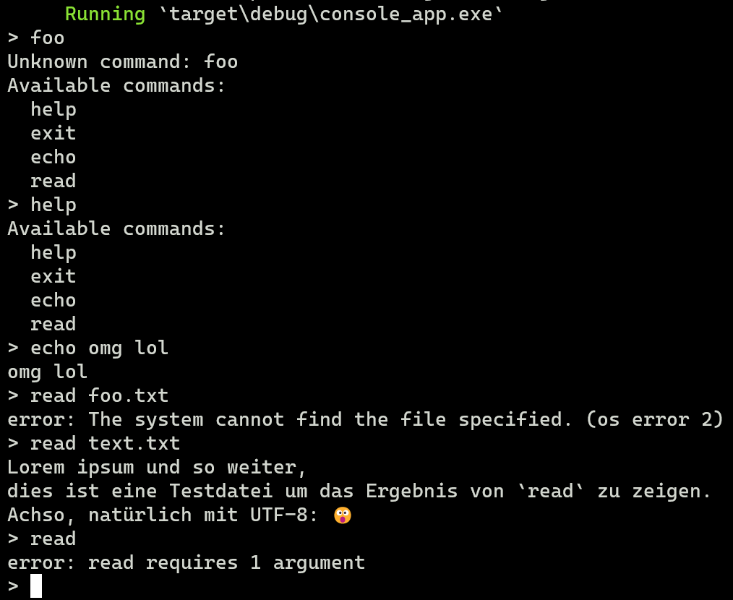
Option and Result
©Philippe Felix Haupt 2023-2024

Slide 112
Option and Result
commands.get(“foo”) returns None, so we enter the else-branch
©Philippe Felix Haupt 2023-2024

Slide 113
Option and Result
commands.get(“help”) returns Some(help), which we call in the if-branch
here we call help(args)
©Philippe Felix Haupt 2023-2024

Slide 114
Option and Result
Hmm…
©Philippe Felix Haupt 2023-2024

Slide 115
Option and Result
This looks oddly simple, is this working properly?
Where did our indentation go? Where’s the match? Where’s the error handling?
©Philippe Felix Haupt 2023-2024

Slide 116
Option and Result
This looks oddly simple, is this working properly?
Where did our indentation go? Where’s the match? Where’s the error handling?
What are those?
©Philippe Felix Haupt 2023-2024

Slide 117
Option and Result
©Philippe Felix Haupt 2023-2024

Slide 118
Option and Result
open() returns a Result, which might either be Ok() or an Err()
©Philippe Felix Haupt 2023-2024

Slide 119
Option and Result
open() returns a Result, which might either be Ok() or an Err()
Result offers many utility methods to chain calls:
If the result is Err(), it calls the closure we provide:
A closure is an anonymous function, here it takes one argument of type io::Error and converts it into an Err(String)
©Philippe Felix Haupt 2023-2024

Slide 120
Option and Result
Result<File, io::Error>
Result<File, String>
©Philippe Felix Haupt 2023-2024

Slide 121
Option and Result
The ? operator in Rust is syntactic sugar and super useful for Results:
If the result is an Err(), it returns that Err() from the current function, otherwise it unwraps the Ok()
This means that if we weren’t able to open the file, we automatically convert the Error to an Err(String), and early exit from the function, in the same line
Otherwise, if we were able to open the file, we automatically unwrap the Result, and store it in file
©Philippe Felix Haupt 2023-2024

Slide 122
Option and Result
file has type File, the Result disappeared!
©Philippe Felix Haupt 2023-2024

Slide 123
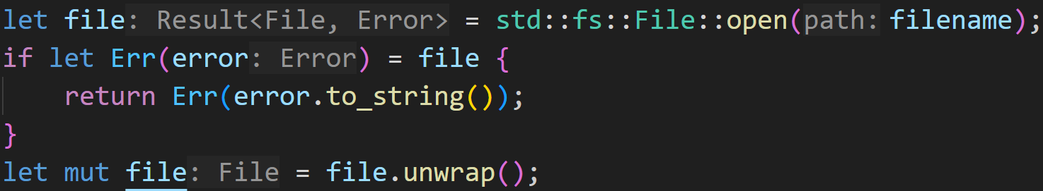
Option and Result
The line above is semantically equivalent to this code:
©Philippe Felix Haupt 2023-2024

Slide 124
Option and Result
The line above is semantically equivalent to this code:
Similarly to how this code returns an Err(), ? can also only be used in functions that return Results themselves. The Ok() type does not matter, but the Err() type has to match up.
©Philippe Felix Haupt 2023-2024

Slide 125
Option and Result
So read:
tries to open a file, returning the error if it fails to do so
tries to read the file, returning that error if it fails to do so
prints the content of said file
returns Ok(), indicating success to the caller function
©Philippe Felix Haupt 2023-2024

Slide 126
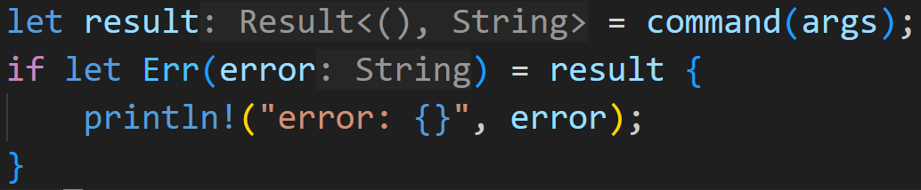
Option and Result
So read:
tries to open a file, returning the error if it fails to do so
tries to read the file, returning that error if it fails to do so
prints the content of said file
returns Ok(), indicating success to the caller function
Any errors are then handled in our main loop
©Philippe Felix Haupt 2023-2024

Slide 127
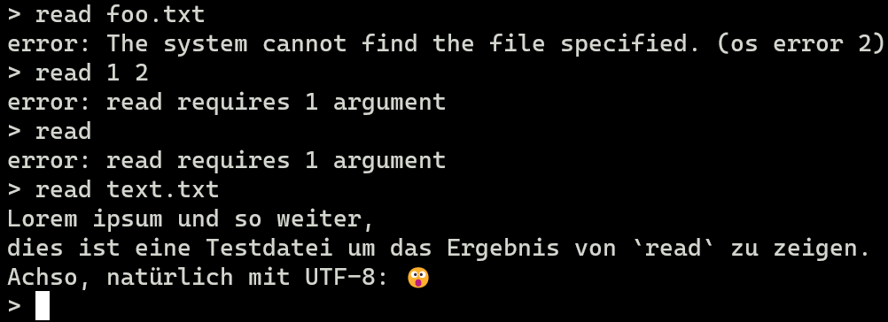
Option and Result
So read:
tries to open a file, returning the error if it fails to do so
tries to read the file, returning that error if it fails to do so
prints the content of said file
returns Ok(), indicating success to the caller function
©Philippe Felix Haupt 2023-2024

Slide 128
Next time
I’ve covered everything that I wanted to cover :)
Next time is our last session, we’ll be doing a Q&A session where I answer any questions that are still unclear
©Philippe Felix Haupt 2023-2024

